Slide 1
Module-3
Deadlocks
1

Slide 2
Contents :
Deadlocks
Introduction
Necessary conditions for deadlocks
Resource Allocation Graph
Methods for handling deadlocks
Deadlock avoidance
Deadlock prevention
Deadlock detection & recovery
2

Slide 3
Deadlocks----System Model
WKT, every process needs some resources like main memory sapce, CPU cycles, files & I/O devices such as printers, keyboard, mouse, peripheral devices, etc
Every system consists of finite number of resources. These resources are distributed among the many competing processes in a multiprogramming environment.
A system may have multiple resources of the same instance. For example, if a system has 4 CPU, then The resource type CPU has 4 instances. similarly, resource type "printer” may have 3 instances.
WKT, a running process may require files or I/O devices to complete its task.
So, when a process needs any resource, it should make request for that & after using, it should release the resource.
3

Slide 4
Deadlocks----System Model
Number of resources requested by a process should not exceed the total number resource of that type. For example, a process should not request 4 printers when there only 3 printers.
Any process requesting for the resource should follow the sequence
1) Request
if a process needs any resource, then it should request for that. If the requested resource is available, immediately it will be allocated to that process.
suppose, if the requested resource is not free at that time, then the process should wait for the resource to become free
2) Use
Once, the resource is allocated to a process, then process can operate (use) that resource.
4

Slide 5
Deadlocks----System Model
3) Release
Once the process finishes its jobs then it should release the resources that it owns.
These are done through system calls like, request(), release(), open(), close() (for files), allocate() & free() (for memory space).
In order to check the availability of the resources, OS maintains a table called system table.
A system table consists of following information
How many resources of each type are there.
How many are allocated
How many are free
which are the process which requests for the particular resource
to which process, resources are allocated
if all the instances of a particular resource are already allocated, if another process request for the same, then that process will be added to the waiting queue of that resource.
5

Slide 6
Deadlocks----System Model
Situation in which 2 or more processes / threads get into a state whereby each is controlling a resource that the other needs, is called deadlock situation.
for example, suppose 2 pirates have each obtained half of a treasure map. Each pirate needs the other half of map to obtain the treasure, but neither will give up his half of the map. This is deadlock.
In software, deadlocks occur because one process holds a resource, file A, while requesting another, file B. At the same time, another process holds the 2nd resource, file B, while requesting the first one, file A. In this situation, both the processes will never get their desired resources to complete their tasks & remains in the deadlock state for ever.
Multithreaded programs are god candidates for deadlock because multiple threads can compete for shared resources
6

Slide 7
Deadlock characterization
In a deadlock, processes never finish executing & system resources are tied up, preventing other jobs from starting.
Necessary conditions
Deadlock situation occurs only when the following 4 events happens simultaneously in a system
Mutual exclusion
only one process should use the resource at a time. (always, resource are non-sharable).
if another process requests that resource, requesting process must be delayed until the resource has been released.
Hold and Wait
a process must be using or holding at least one resource & waiting to acquire additional resources that are currently being held by other processes
7

Slide 8
Deadlock characterization
No pre-emption
resources cannot be pre-empted, i.e., a resource can be released only voluntarily by the process holding it, after that process has completed its task.
4) Circular wait
A set of waiting processes { P0,P1,P2,……..Pn} must exist such that P0 is waiting for a resource held by P1, P1 is waiting for a resource held by P2, ……………Pn-1 is waiting for resource held by Pn and Pn is waiting for resource held by P0.
8

Slide 9
Resource Allocation Graph
Deadlocks can be described more efficiently through a directed graph called system resource allocation graph
This graph consists of set of vertices V and a set of edges E
Set of vertices/nodes are classified into 2 types
Set of active processes, P={ P1, P2, P3, ……..Pn }
Set of all resources, R= _ R1, R2, R3, ……….Rm }
If any process Pi requests any resource Ri, then it is represented as Pi→Ri, that means, when Pi requests one instance of Ri then it is represented as Pi→Ri and then Pi goes to waiting state to get one instance of Ri.
If one instance of any resource Ri is allocated to any process Pi, then it is represented as Ri→Pi
A directed edge Pi→Ri is called request edge and a directed edge Ri→Pi is called assignment edge
In this graph, processes are represented as circle & resources are represented as rectangle with some dots.
This dots represents number of instances of that particular resource
9

Slide 10
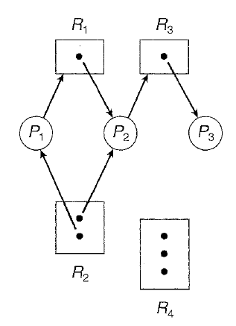
Resource Allocation Graph
The sets P, R and E:
P = {P1, P2, P3} R= {R1, R2, R3, R4}
E = {Pl→ Rl, P2→R3. Rl→P2, R2→P2, R2→Pl, R3→P3}
Resource instances:
One instance of resource type R1
Two instances of resource type R2
One instance of resource type R3
Three instances of resource type R4
By observing resource allocation graph, we can say processes are in
Deadlock situation or not.
If the graph contains no cycles then we can say there is no deadlock
If the graph contains any cycle, then deadlock may exist (but it is not sure)
If there is only one instance of all the resources & the graph is having cycle, then we can say surely that, there is a deadlock
10

Slide 11
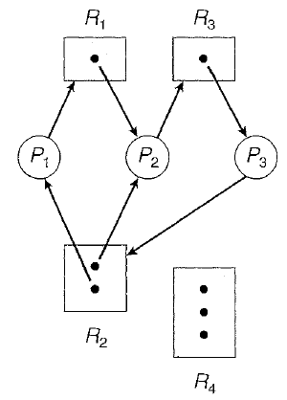
Resource Allocation Graph
Consider again example 1, with P3 requesting an instance of P2.
Now, its resource allocation graph is as shown
In this graph, there are 2 cycles
1) P1→R1→P2→R3→P3→R2→P1
2) P2→R3→--P3→R2→P2
1st cycle indicates P1, P2 and P3 are deadlocked
2nd cycle indicates P2 and P3 are deadlocked
Here deadlock occurs because no instances of any resource is free (all are
allocated)
Each process is holding one or more resource & requsting for another
resource which is hold by another process
11

Slide 12
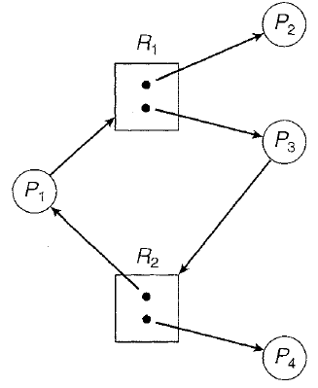
Resource Allocation Graph
Now consider the resource allocation graph as shown
Here, even though graph is having cycle, there is no deadlock
SUMMARY
1) if resource allocation graph does not having any cycle, then it indicates
there is no deadlock situation
2) if resource allocation graph is having cycle, deadlock may appear.
There are 2 cases
a) if there is a cycle & all the resource instances are still free then there is
no deadlock
b) if there is a cycle & all the instances of all the resources are already
allocated (not free) then there is a deadlock situation.
12

Slide 13
Methods for handling deadlocks
If deadlocks are not recovered, then system performance decreases, because more & more upcoming processes are keeps on requesting for the resources but all are allocated, no one is free.
So eventually, system will stop functioning & will need to be restarted manually
So, deadlocks have to be prevented or avoided, if occurred it has to be recovered
To handle the deadlocks, some measures or methods has to be followed:
1) some protocols has to be used to prevent or avoid deadlocks, ensuring that system will never enter the deadlock state
2) if deadlock occurs, it should be detected & recovered in an efficient way
3) if deadlock occurs, ignore the problem altogether & pretend that deadlock never occur in the system
The 3rd solution is the one used by most of the Oss including windows and unix.

Slide 14
Deadlock prevention
We know that, deadlock occurs only when all of the 4 following conditions are occurred:
1) mutual exclusion
2) Hold & wait
3) No preemption
4) Circular wait.
Deadlocks can be prevented by avoiding any one of the above mentioned 4 events.
Mutual exclusion
if all the resources are sharable, then there is no chance of deadlock.
For example, Read only files are sharable resources. if several processes attempt to open a read-only file at the same time, they can be granted simultaneously. In this case, no process need to wait for sharable resources & hence no deadlock. But there are some resources which cannot be shared by several processes at the same time. For example, printer, scanner, etc.
in general, it is not possible to prevent deadlocks by denying the mutual-exclusion condition, because some resources are intrinsically non-sharable.

Slide 15
Deadlock prevention
Hold and Wait
There are some possibilities to avoid deadlock by avoiding this hold & wait Condition.
A process is allowed to request for any resources only when it doesn't have (not holding) resources.
Another way is, process is allowed to execute only when it is having all of its resources required to complete their task.
Once process is having all of its resources, then it can be allowed to execute. In this case, there is no requesting for any other recourse & no waiting & hence no deadlock.
So, it is the responsibility of the OS to allocate all the resources to a process but practically it is having some disadvantages like starvation & less utilization of resources.
If all the resources are allocated to a process & it is taking long time to complete its task, other processes has to wait for long period of time which leads to starvation.

Slide 16
Deadlock prevention
No Pre-emption
We can avoid deadlock by avoiding no-preemption.
It can be done in 2 ways.
1) when a process request for any resource & it is already allocated, then this process has to wait until that requested resource becomes free.
If that process is having (holding) some resources, then those resources has to be preempted (released)
These released resources are added to the list of available resources so that other processes which are waiting for these can be benefited.
process which is preempted(released) all of its resources, that has to be restarted only when it can regain its old resources & as well as new ones that it is requesting
2) when a process requests for any resource, it will be get allocated if it is free.
if the requested resource is not free, then check whether they are allocated to some other processes which are also waiting for some other resources
if they are waiting for some other resources, pre-empt(release) those & allocated to the requested process.

Slide 17
Deadlock prevention
Circular Wait
One way to avoid circular wait is to assign unique numbers to all the resources & then making the processes to request the resources only in strictly increasing ( or decreasing) order.
In order to assign a natural number to every resource, one-to-one function is used which is defined as F:R→N N is a set of natural numbers and R is set of resources
Let R includes tape drives, disk drives & printers, then the function F might be defined as
F(tape drive)=1 F(disk drive)=5 F(Printer)=12
First method used to avoid circular wait is to make processes to request the resources in increasing order
Assume, first one process request for Ri.
Then, this process has to request for another resource say Rj if and only if F(Rj) > F(Ri)
For example, P1 requests for disk drive, then after some time, it can request only printer because F(printer)>F(disk drive) but it cannot request for tape drive because F(tape drive) is not greater than F(disk drive)
Once P1 is using disk drive & also printer, then it cannot request for tape drive. So, there is no possibility of circular wait

Slide 18
Deadlock prevention-----circular wait contd
Circular Wait
Another method used to avoid circular wait is, to make process to request for any resource Rj only after releasing any resources Ri such that F(Ri)>=F(Rj)
For example, assume process P1 is using tape drive & then it requests for printer. It is allowed because F(printer)>F(tape drive)
Now, P1 is using both tape drive and printer
Assume, P1 needs disk drive but it cannot request because F(disk drive) is not greater than F(printer)
So, now release all the resources which are having value greater than or equal to disk drive
Once all the resources are released, process P1 will be in no waiting state & hence there is no circukar wait.

Slide 19
Deadlock avoidance
Circular Wait
Another method used to avoid circular wait is, to make process to request for any resource Rj only after releasing any resources Ri such that F(Ri)>=F(Rj)
For example, assume process P1 is using tape drive & then it requests for printer. It is allowed because F(printer)>F(tape drive)
Now, P1 is using both tape drive and printer
Assume, P1 needs disk drive but it cannot request because F(disk drive) is not greater than F(printer)
So, now release all the resources which are having value greater than or equal to disk drive
Once all the resources are released, process P1 will be in no waiting state & hence there is no circukar wait.

Slide 20
Deadlock prevention-----circular wait contd
Circular Wait
Another method used to avoid circular wait is, to make process to request for any resource Rj only after releasing any resources Ri such that F(Ri)>=F(Rj)
For example, assume process P1 is using tape drive & then it requests for printer. It is allowed because F(printer)>F(tape drive)
Now, P1 is using both tape drive and printer
Assume, P1 needs disk drive but it cannot request because F(disk drive) is not greater than F(printer)
So, now release all the resources which are having value greater than or equal to disk drive
Once all the resources are released, process P1 will be in no waiting state & hence there is no circukar wait.

Slide 21
Deadlock avoidance
WKT, deadlock can be avoided by avoiding any one of 4 Conditions, mutual exclusion, hold & wait, no preemption & circular wait.
If we use this method to avoid deadlock, then it leads to
*) less utilization of resources &
*) reduces the system throughput.
So we need some other methods to avoid deadlocks.
An alternative method used to avoid deadlock is to maintain additional information about the processes & all the resources.
with this additional information, system should decide
*) which process is requesting which resource
*) whether that resource is available or not
*) whether requested resource can be allocated or allowing that requested process to wait
There are many algorithms which uses this approach but they differ from amount & type of information required.

Slide 22
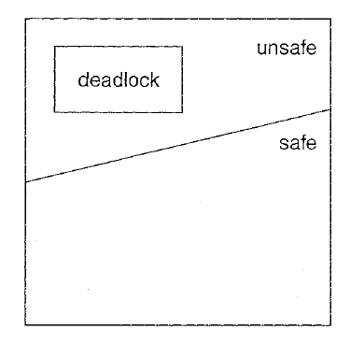
Deadlock avoidance
Simplest & most useful method is that which makes process to declare maximum number of resources it requires to do it's task.
With this prior information, an algorithm can be constructed which avoids the system from entering into a deadlock state.
Safe state
A state is safe, if the system can allocate all the requested resources to a process & avoiding that process to enter into the deadlock state
If system is in safe state, then there is no way of deadlock
If system is in unsafe state, then it may leads to deadlock.
But, not all unsafe states are deadlock
As long as the state is in safe state, OS can avoid
unsafe & also deadlocked state.

Slide 23
Resource allocation graph algorithm
From resource-allocation graph, it is Known that, if there is only one instance of all the resources & the graph is having cycle, then it indicates deadlock situation.
we also know, about request edge (Pi→Rj) and assignment edge (Rj→ Pi).
In this resource-allocation graph algorithm, we use one more type of edge called claim edge.
A claim edge is a dotted edge Pi - - - - - > Rj which indicates that process Pi may request resource Rj in future.
When a process requests resource, then claim edge is Converted into request edge. (as Pi- - - - > Rj into Pi→ Rj)
Similarly, when a process releases the resource, then assignment edge is converted into claim edge (ie, Rj → Pi into Pi- - - - >Rj).
In this, resource allocation graph algorithm, all the claim edges should be included in the graph before any process starts executing.
But, relaxation can be given to this condition, by allowing a claim edge Pi- - - - >Rj to be added to the graph only if all the edges associated with Pi are claim edges.
"A sequent edge Pi→ Rj can be converted into arrignment edge Rf→ Pi only when this arrignment edge does not form the cycle in this resource alteration graph.If cycle is found, it indicates that rystem is in unrafe state & hence indicates deadlock Go situation.So, in this way we can avoid the deadlock.

Slide 24
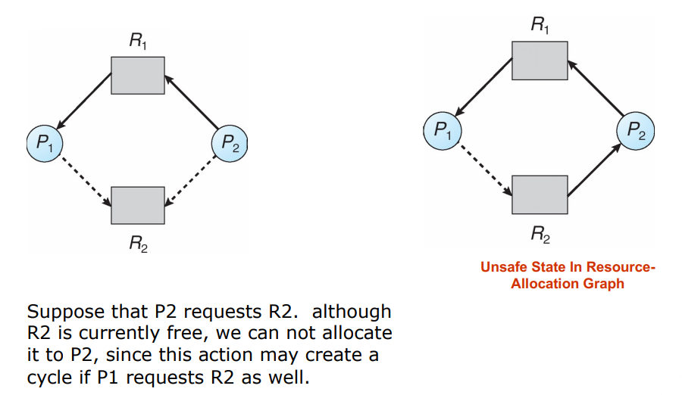
Resource allocation graph algorithm
A request edge Pi→ Rj can be converted into assignment edge Rj→ Pi only when this assignment edge does not form the cycle in this resource alteration graph.
If cycle is found, it indicates that system is in unsafe state & hence indicates deadlock situation.
So, in this way we can avoid the deadlock.

Slide 25
Bankers algorithm
For resource types with Multiple instances, Banker’s algorithm is to be used
Each process must a priori claim maximum use.
When a process requests a resource it may have to wait.
When a process gets all its resources it must return them in a finite amount of time.

Slide 26
Bankers algorithm
Let n = number of processes, and m = number of resources types.
Available: Vector of length m. If available [j] = k, there are k instances of resource type R_{j} available.
Max: n x m matrix. If Max [i,j] = k, then process P_{i} may request at most k instances of resource type R_{j}.
Allocation: n x m matrix. If Allocation[i,j] = k then P_{i} is currently allocated k instances of R_{j.}
Need: n x m matrix. If Need[i,j] = k, then P_{i} may need k more instances of R_{j} to complete its task.
Need [i,j] = Max[i,j] – Allocation [i,j].

Slide 27
Bankers algorithm
Banker’s algorithm consists of a Safety algorithm and a Resource request algorithm.
Safety Algorithm
The algorithm for finding out whether or not a system is in a safe state can be described as follows:
1. Let Work and Finish be vectors of length m and n, respectively. Initialize:
Work = Available
Finish [i] = false for i = 0, 1, …, n- 1.
2. Find and i such that both:
(a) Finish [i] = false
(b) Need_{i} ≤ Work
If no such i exists, go to step 4.
3. Work = Work + Allocation_{i} Finish[i] = true go to step 2.
4. If Finish [i] == true for all i, then the system is in a safe state.

Slide 28
Bankers algorithm
Resource-Request Algorithm for Process P_{i}
Request = request vector for process P_{i}. If Request_{i} [j] = k then process P_{i} wants k instances of resource type R_{j.}
1. If Request_{i} ≤ Need_{i} go to step 2. Otherwise, raise error condition, since process has exceeded its maximum claim.
2. If Request_{i} ≤ Available, go to step 3. Otherwise P_{i} must wait, since resources are not available.
3. Pretend to allocate requested resources to P_{i} by modifying the state as follows:
Available = Available – Request;
Allocation_{i} = Allocation_{i} + Request_{i};
Need_{i} = Need_{i} – Request_{i};
If safe ⇒ the resources are allocated to Pi.
If unsafe ⇒ Pi must wait, and the old resource-allocation state is restored

Slide 29
Bankers algorithm
Example 1
5 processes P₀ through P₄;
3 resource types:
A (10 instances), B (5instances), and C (7 instances).
Snapshot at time T₀:
Allocation Max Available
A B C A B C A B C
P₀ 0 1 0 7 5 3 3 3 2
P₁ 2 0 0 3 2 2
P₂ 3 0 2 9 0 2
P₃ 2 1 1 2 2 2
P₄ 0 0 2 4 3 3

Slide 30
Bankers algorithm
Example 1(contd.)
The content of the matrix Need is defined to be Max – Allocation.
Need A B C
P₀ 7 4 3
P₁ 1 2 2
P₂ 6 0 0
P₃ 0 1 1
P₄ 4 3 1
The system is in a safe state since the sequence < P₁, P₃, P₄, P₂, P₀> satisfies safety criteria.

Slide 31
Bankers algorithm
Example 1(contd.)
Check that Request ≤ Available (that is, (1,0,2) ≤ (3,3,2) ⇒ true.
Allocation Need Available
A B C A B C A B C
P₀ 0 1 0 7 4 3 2 3 0
P₁ 3 0 2 0 2 0
P₂ 3 0 1 6 0 0
P₃ 2 1 1 0 1 1
P₄ 0 0 2 4 3 1
Executing safety algorithm shows that sequence < P₁, P₃, P₄, P₀, P₂> satisfies safety requirement.
Can request for (3,3,0) by P₄ be granted?
Can request for (0,2,0) by P₀ be granted?

Slide 32
Bankers algorithm
More Practice Problems on Banker’s Algorithm

Slide 33
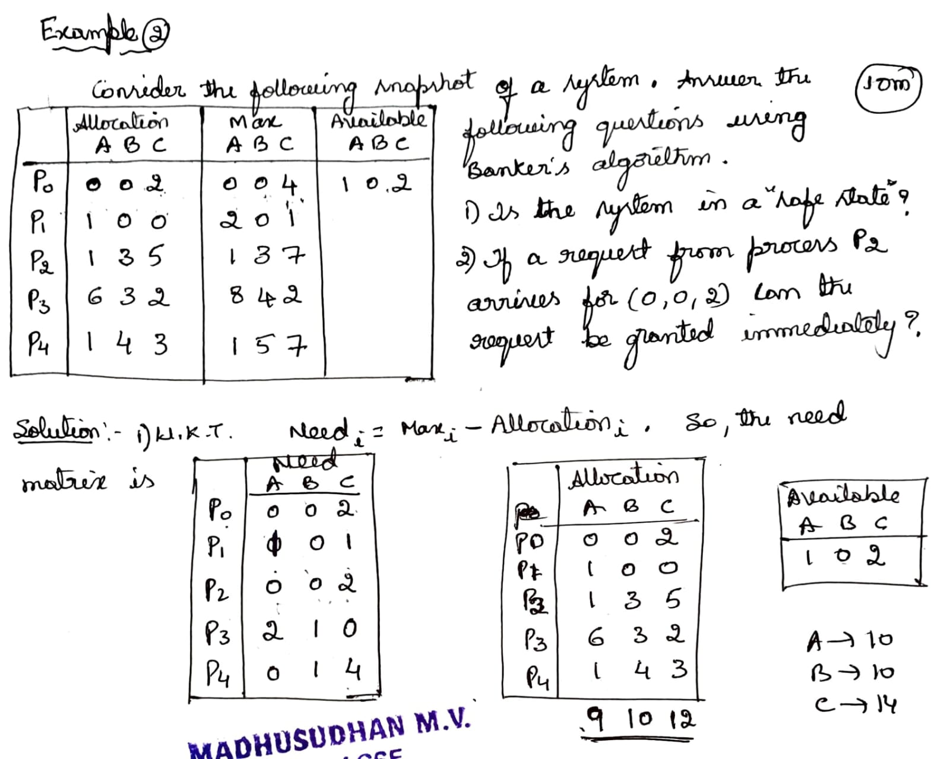
Bankers algorithm

Slide 34
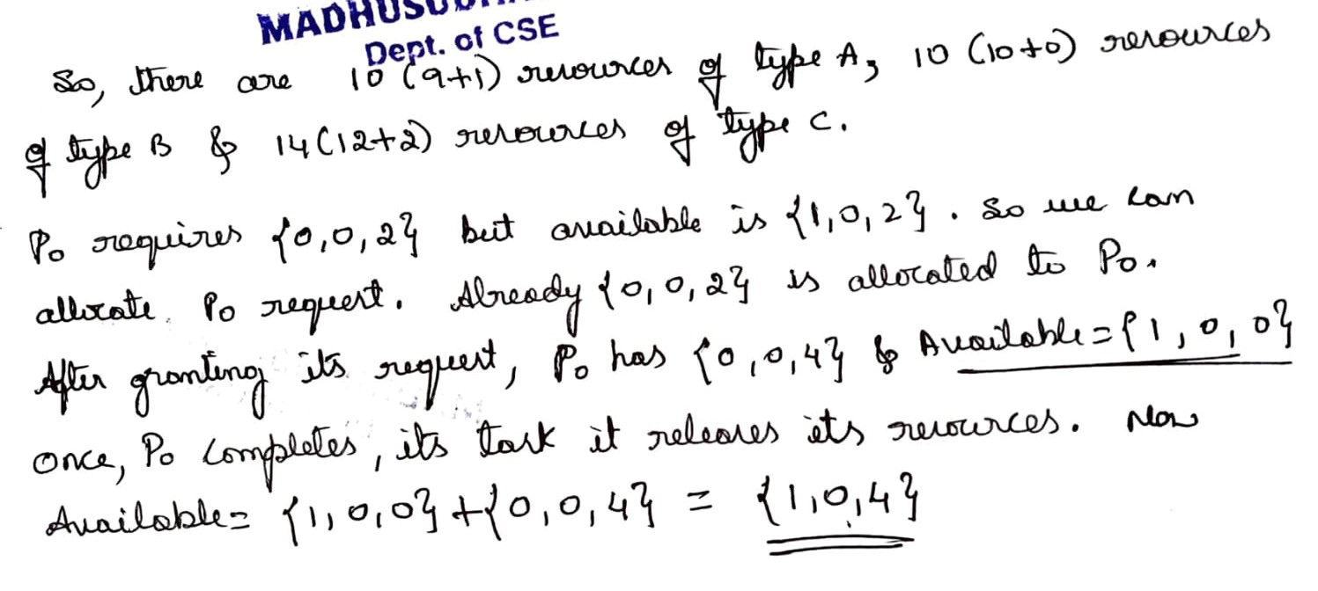
Bankers algorithm

Slide 35
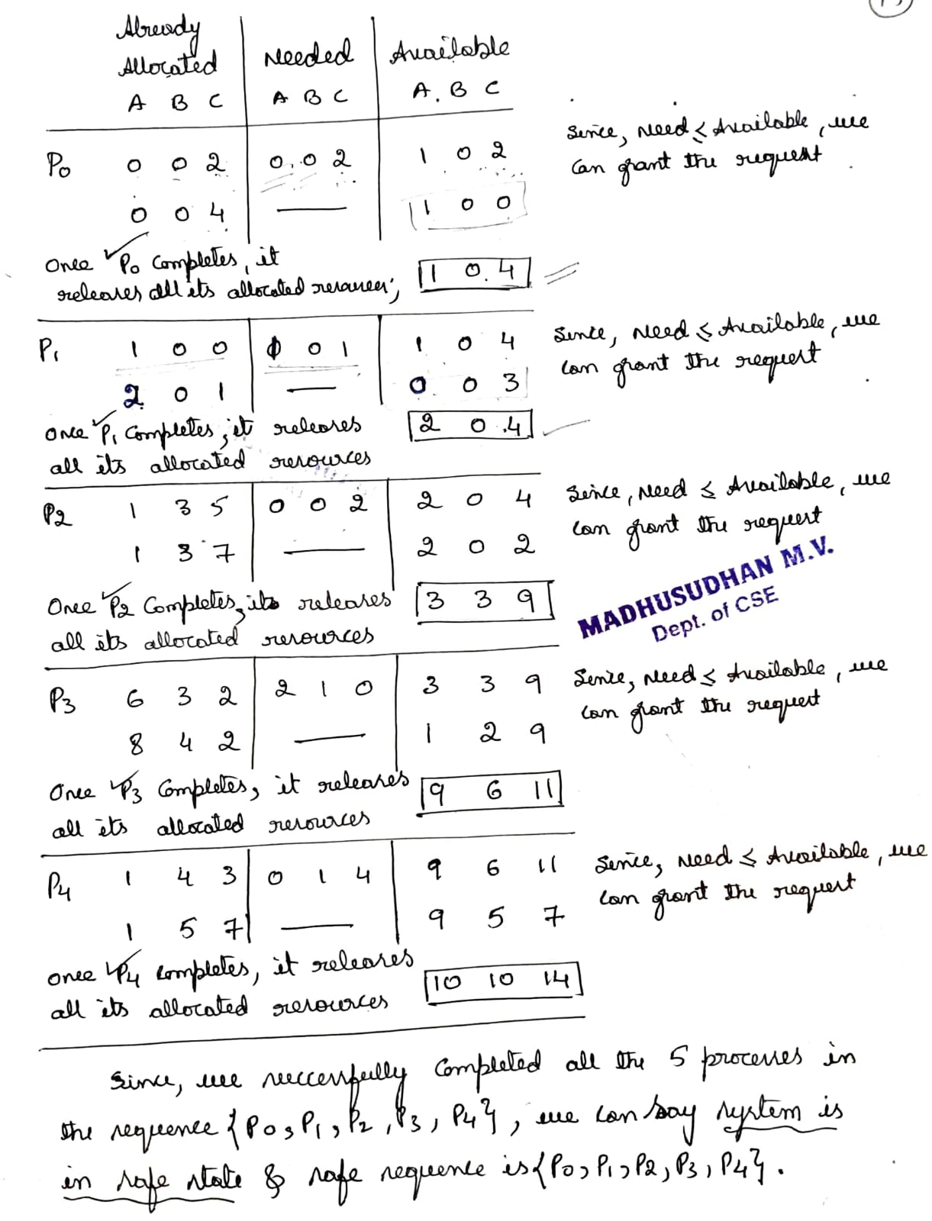
Bankers algorithm

Slide 36
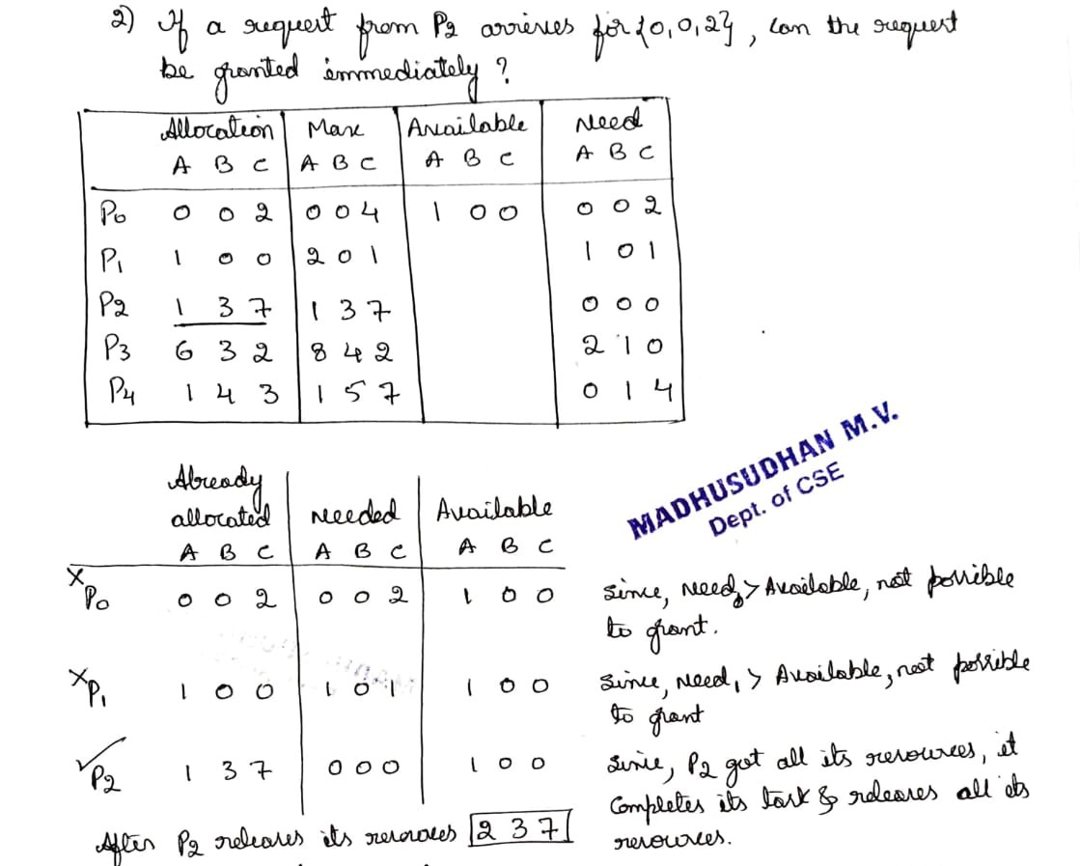

Slide 37
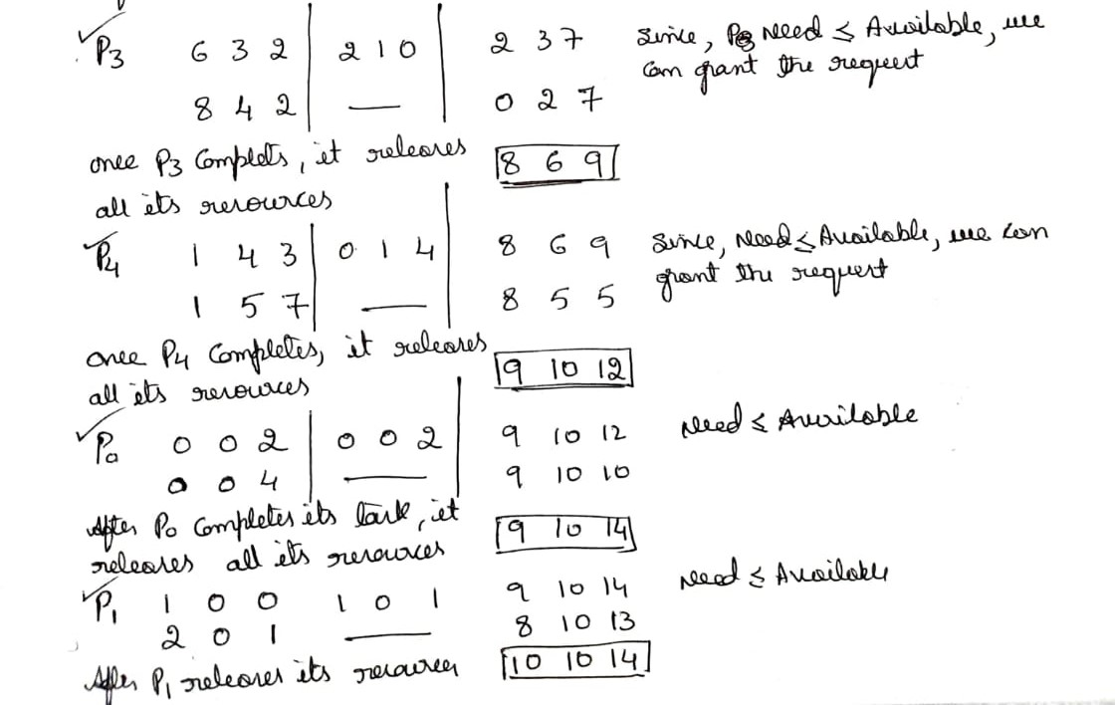

Slide 38
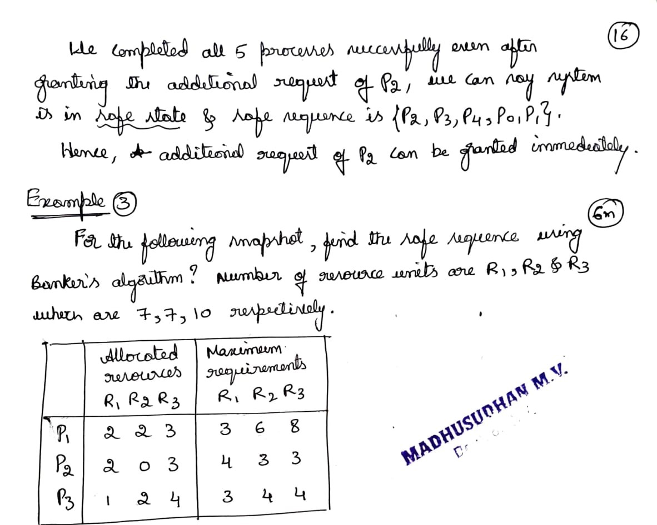

Slide 39
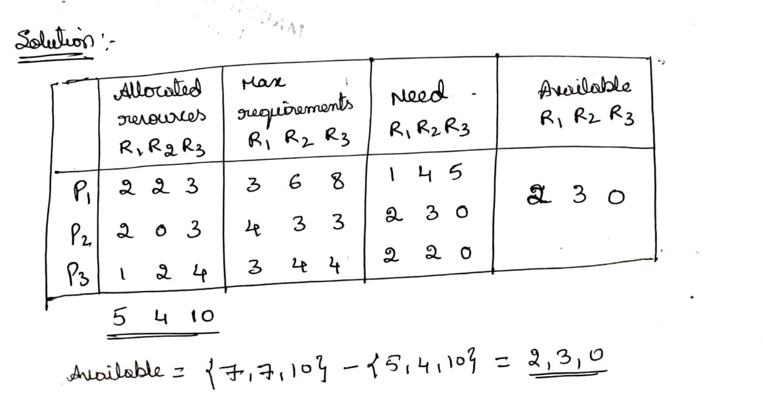

Slide 40
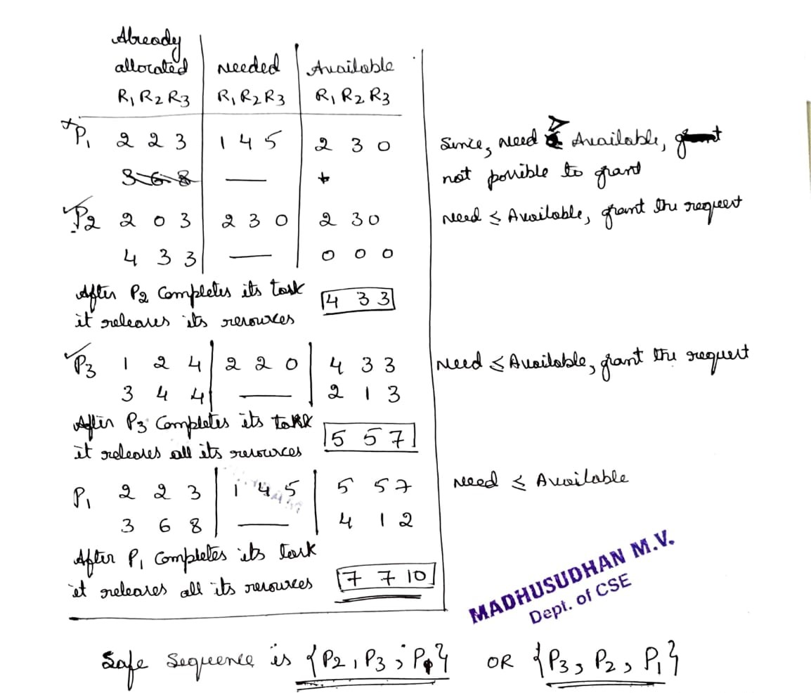

Slide 41
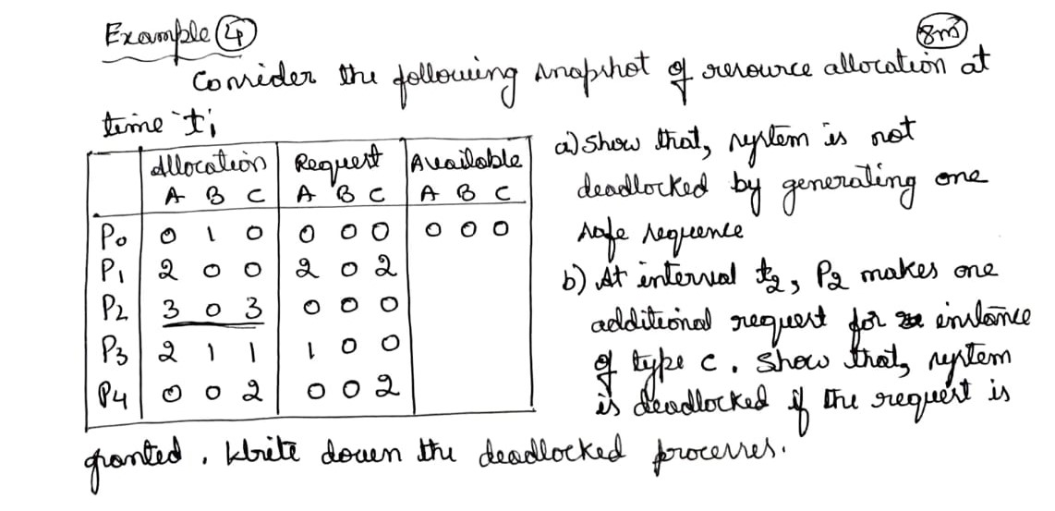

Slide 42
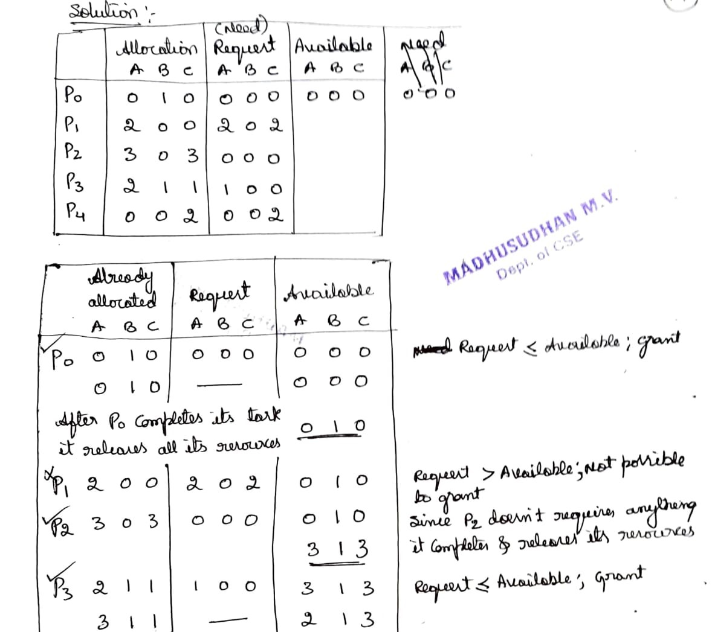

Slide 43
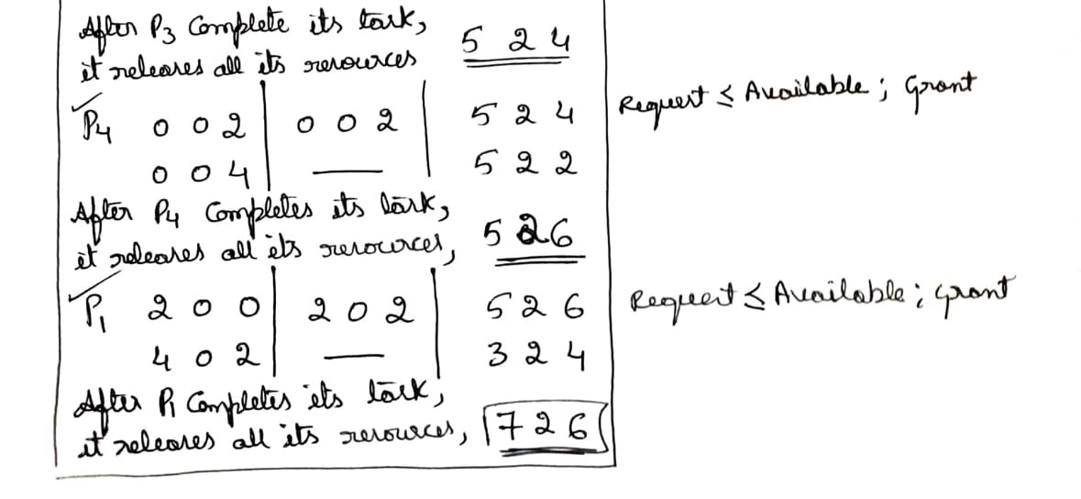

Slide 44
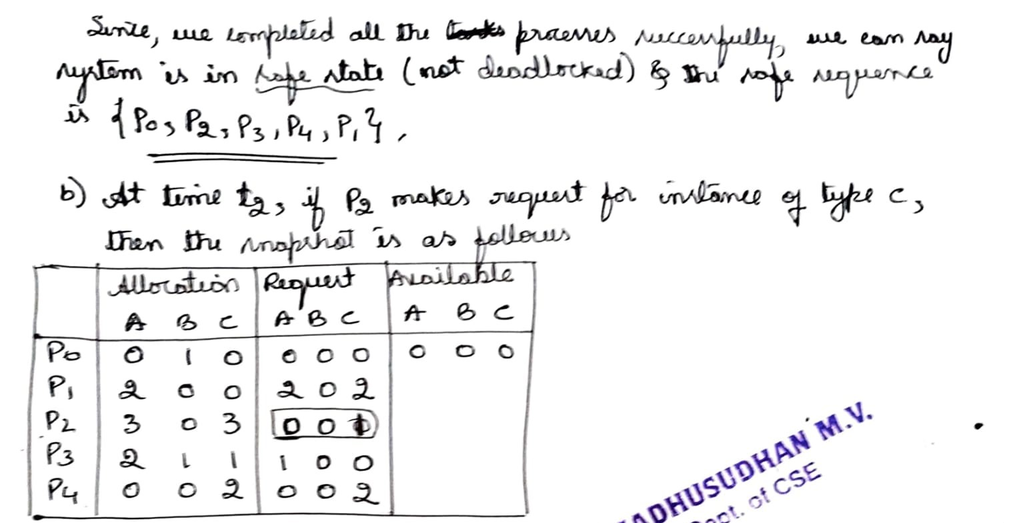

Slide 45
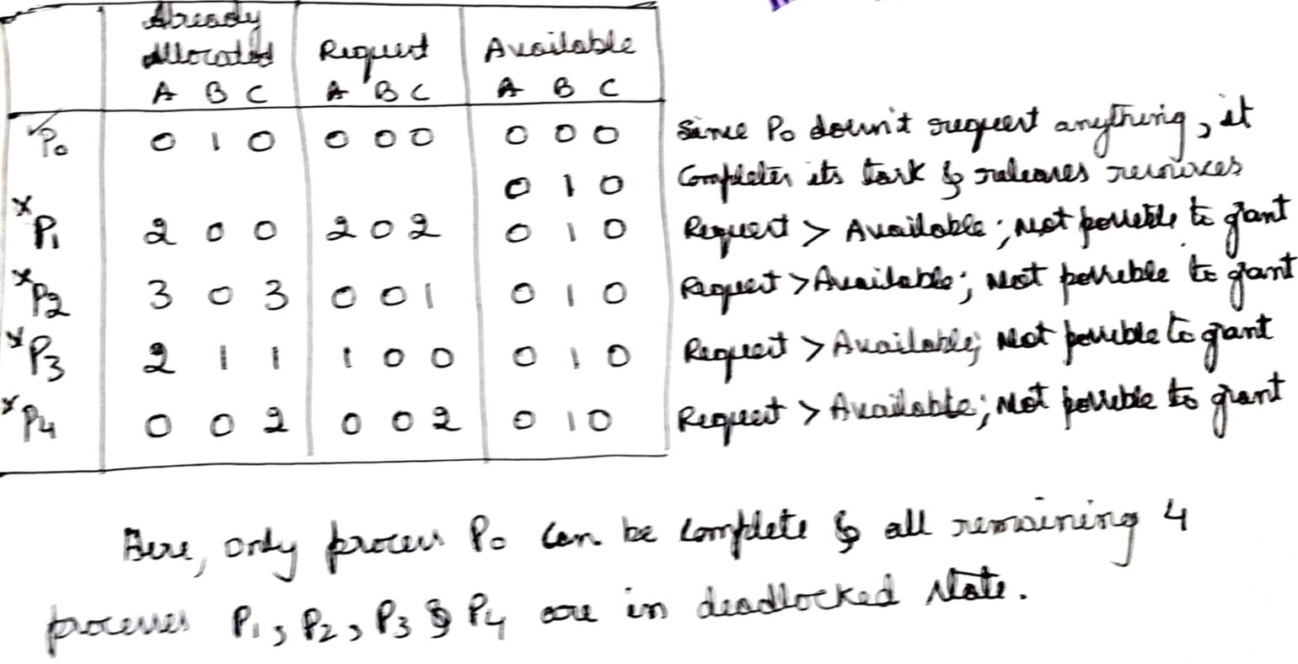

Slide 46
Deadlock Detection
Allow system to enter deadlock state
Detection algorithm
Recovery scheme

Slide 47
Deadlock Detection
Single Instance of each Resource type
Maintain wait-for graph
Nodes are processes.
P_{i} → P_{j} if P_{i} is waiting for P_{j}.
Periodically invoke an algorithm that searches for a cycle in the graph. If there is a cycle, there exists a deadlock.
An algorithm to detect a cycle in a graph requires an order of n² operations, where n is the number of vertices in the graph.

Slide 48
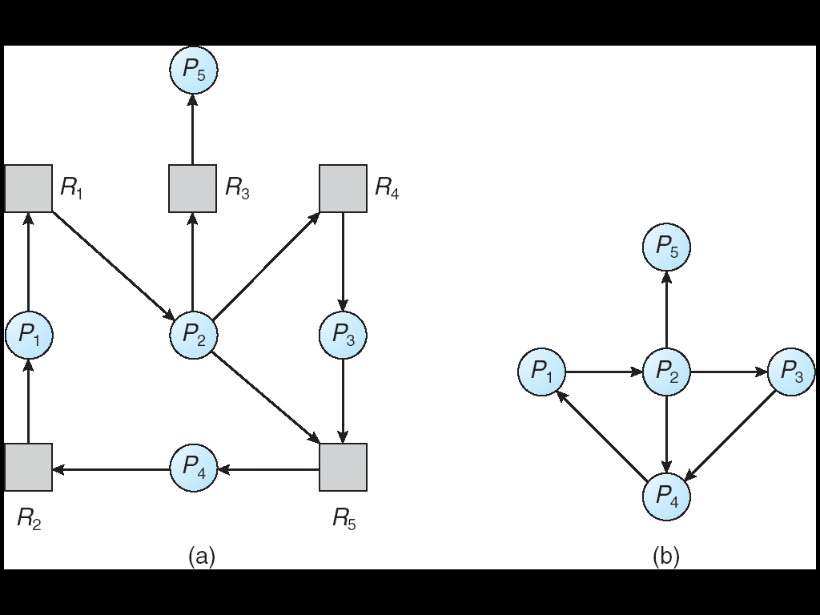
Deadlock Detection
Resource Allocation Graph Corresponding Wait-for-Graph

Slide 49
Deadlock Detection
Several instances of a Resource type
Detection Algorithm
Available: A vector of length m indicates the number of available resources of each type.
Allocation: An n x m matrix defines the number of resources of each type currently allocated to each process.
Request: An n x m matrix indicates the current request of each process. If Request [i_{j}] = k, then process P_{i} is requesting k more instances of resource type. R_{j}.

Slide 50
Deadlock Detection
Detection Algorithm
1. Let Work and Finish be two arrays of length m and n, respectively Initialize:
(a) Work = Available
(b) For i = 1,2, …, n, if Allocation_{i} ≠ 0, then Finish[i] = false; otherwise, Finish[i] = true.
2. Find an index i such that both:
(a) Finish[i] == false
(b) Request_{i} ≤ Work
If no such i exists, go to step 4.
3. Work = Work + Allocation_{i} Finish[i] = true go to step 2.
4. If Finish[i] == false, for some i, 1 ≤ i ≤ n, then the system is in deadlock state. Moreover, if Finish[i] == false, then P_{i} is deadlocked.

Slide 51
Deadlock Detection
Example
Five processes P₀ through P₄; three resource types A (7 instances), B (2 instances), and C (6 instances).
Snapshot at time T₀:
Allocation Request Available
A B C A B C A B C
P₀ 0 1 0 0 0 0 0 0 0
P₁ 2 0 0 2 0 2
P₂ 3 0 3 0 0 0
P₃ 2 1 1 1 0 0
P₄ 0 0 2 0 0 2
Sequence <P₀, P₂, P₃, P₁, P₄> will result in Finish[i] = true for all i.

Slide 52
Deadlock Detection
Example(contd)
P₂ requests an additional instance of type C.
Request
A B C
P₀ 0 0 0
P₁ 2 0 1
P₂ 0 0 1
P₃ 1 0 0
P₄ 0 0 2
State of system?
Can reclaim resources held by process P₀, but insufficient resources to fulfill
other processes; requests.
Deadlock exists, consisting of processes P₁, P₂, P₃, and P₄.

Slide 53
Deadlock Detection
Detection Algorithm Usage
When, and how often, to invoke depends on:
How often a deadlock is likely to occur?
How many processes will need to be rolled back?
→one for each disjoint cycle
If detection algorithm is invoked arbitrarily, there may be many cycles in the resource
graph and so we would not be able to tell which of the many deadlocked processes
“caused” the deadlock.

Slide 54
Recovery from Deadlock-Process Termination
Abort all deadlocked processes.
Abort one process at a time until the deadlock cycle is eliminated.
In which order should we choose to abort?
Priority of the process.
How long process has computed, and how much longer to completion.
Resources the process has used.
Resources process needs to complete.
How many processes will need to be terminated.
Is process interactive or batch?

Slide 55
Recovery from Deadlock-Resource Preemption
Selecting a victim – minimize cost.
Rollback – return to some safe state, restart process for that state.
Starvation – same process may always be picked as victim, include number of rollback in cost factor.

